Slide 1

Social media attributions in the context of water crisis
Rupak Sarkar, Sayantan Mahinder, Hirak Sarkar, Ashiqur R. KhudaBukhsh
Adorin Kripanand Lucas, Aishwarya Manapuram, Daksh Chaudhary
CSI5386 Seminar (Nov 28 2022)
uOttawa.ca

Slide 2
Motivation
•Water crisis is one of the pressing current environmental challenges. Studies state that nearly One-third of the world’s most extensive groundwater systems are under severe stress. (Richey et al., 2015).
•The forecasts look even more grim; nearly two-thirds of the world population could be water stressed by 2025. (Seckler et al., 1999).
•While the crisis has reached an alarming level far and wide, India is listed as one of the major at-risk countries. In June 2019, the longstanding Chennai water crisis escalated into an international talking point, revealing alarming statistics of the water crisis in India looming in near future. (WashingtonPost, 2019)
•Attribution of natural disasters/collective misfortune is a widely-studied political science problem. However, such studies typically rely on surveys, expert opinions, or external signals such as voting outcomes.

Slide 3
•Despite the presence of a large body of political science literature on retrospective voting (see, e.g., Ferejohn 1986; Peffley 1984) or psychological literature on attribution (see, e.g., Shaver 2012), Apportioning attribution for a collective crisis or misfortune still remained as a challenge in social science. Prior social science literature (Griffin et al., 2008) primarily relies on traditional surveys for attribution analysis.
•But, unlike traditional surveys, social media analyses are vastly cheaper, have faster turnaround time, can be conducted at different spatiotemporal granularities and aggregate a larger number of opinions than traditional surveys can usually afford.

Slide 4
Problem Formulation
In this context, a new task of inferring attribution ties is defined through a large scale analysis of relevant social media discussions. We explore the viability of using unstructured, noisy social media data to complement traditional surveys through automatically extracting attribution factors.
This paper focuses on the 2019 Chennai water crisis that rapidly escalated into a discussion topic with global importance following alarming water-crisis statistics.
INPUT: A challenging data set constructed from YouTube comments (72,098 comments posted by 43,859 users on 623 videos relevant to the crisis)
OUTPUT: A neural baseline is presented to identify attribution ties that achieves a reasonable performance (accuracy: 87.34% on attribution detection and 81.37% on attribution resolution).

Slide 5
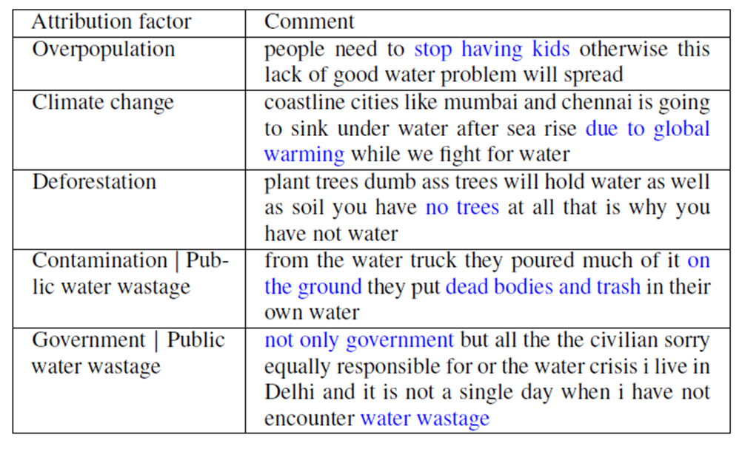
•Here, the main machine learning contributions are a new task of detecting attribution ties from unstructured web data and baselines that automatically detect them. Below Table lists a few example comments from the data set.
• We argue that the task of attribution ties detection is a challenging NLP task that requires subtle understanding of language constructs.
•Consider the following example: ‘stop have 9 kids family’. In this comment, a growing population is attributed as the possible cause of the water crisis. While there is no surface level text match with the term ‘population’, humans can still infer it from the semantic equivalence of population’ and ‘9 kids family’.

Slide 6
•In this example, we again see that the same phrase ‘9 kids family’ is present, yet the comment is not attributing to ‘population’ for the water crisis.
•As there can be many equivalent ways of expressing attributions, a semantic understanding of the language is necessary for the task. Moreover, although necessary, establishing semantic equivalence is not sufficient for attribution detection. To correctly detect an attribution tie, we also need to understand the context in which an attribution factor is mentioned. Finally, scarcity of labelled data and the informal nature of conversation in social media pose additional challenges.
•Water crisis has received sustained research focus in a diverse set of fields such as food policy research (Hanjra and Qureshi, 2010), earth sci- ence (Qin et al., 2007), social science (Foltz, 2002), and water research (Schindler and Donahue, 2006; Narula et al., 2011; von Medeazza, 2006), encompassing a broad range of dimensions including the socio-hydrological, ethical, cultural, and foreign policy aspects of the crisis. This paper’s work relies on these lines of research to compile a list of possible attribution factors (see below Table).

Slide 7
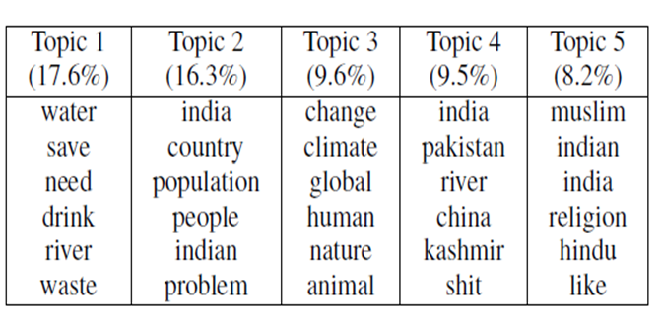
•However, their focus is different as they seek to tackle the NLP challenges associated with analyzing attributions from noisy social media data.
•In this paper, a pre-trained language model (LM) is used to leverage transfer learning and overcome the challenge of paucity of labelled data. Furthermore, it is demonstrate that fine-tuned, pre-trained LMs on Indian social media data have the ability to generalize and tackle the quirks of English written by non-native speakers. We find that applying such models improves the performance on the attribution detection task.

Slide 8
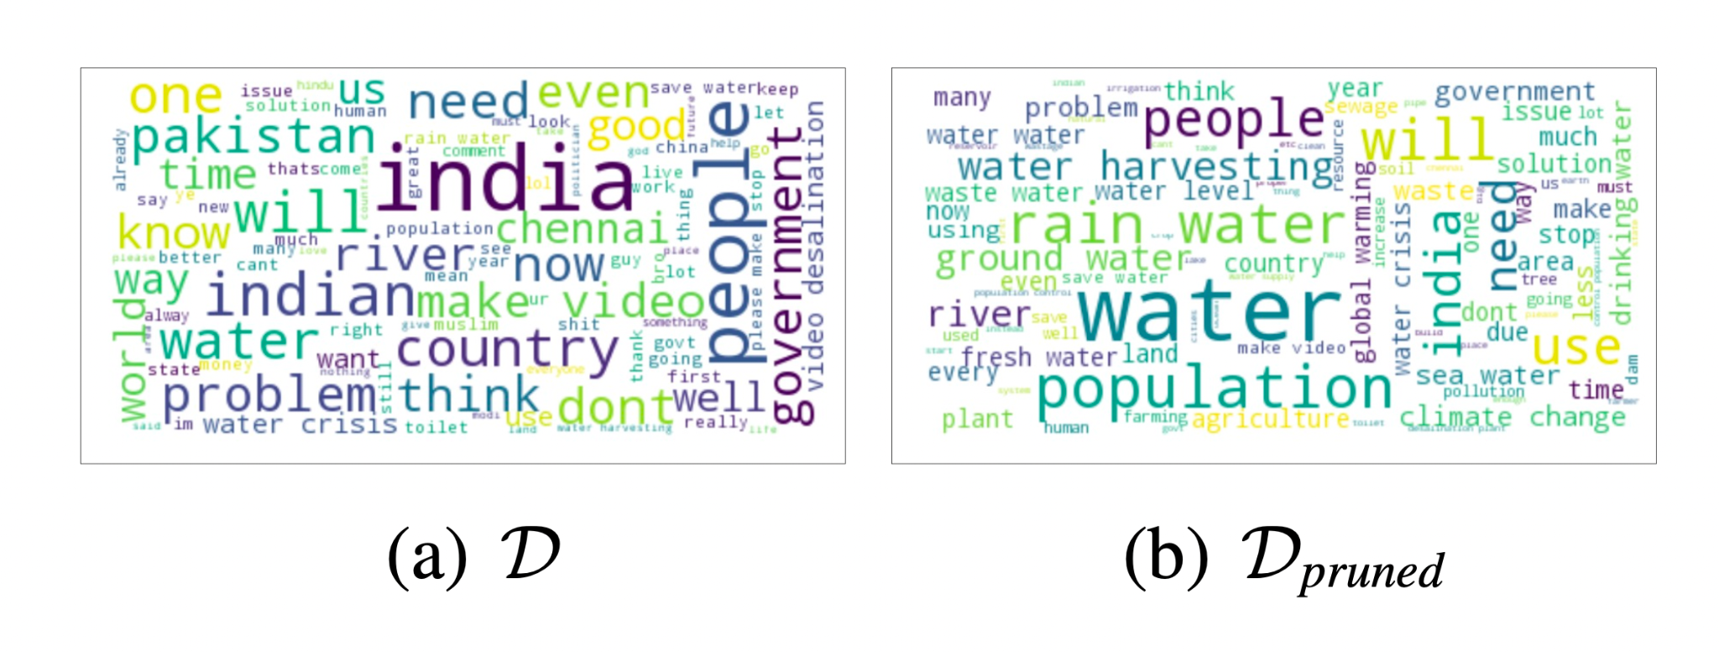
Data Collection
The data being used here is obtained from youtube’s search API
Queries related to water crisis are passed to youtube’s search API and the resulting videos are added to a video set.
The video set is then processed to remove the duplicate videos and then is pruned.
The comments on this pruned video set is then obtained using the youtube data API.
These extracted comments are the data that is being used for attribution.
Since the dataset is of a multilingual country, the data in english alone needs to be extracted for the next processes.
Some of the general challenges such as spelling mistakes, out of vocabulary words and grammatical mistakes affect the precision of the data.

Slide 9
Data Pruning
A list of factors is obtained by research on water crisis.
To generate this list, literature corresponding to the global water crisis, water crisis in a specific region, and the water crisis in the targeted location are considered.
List of factors: topographical disadvantage, weather, climate change, global warming, industrial development, petroleum industry, water intensive industries, oil sands development expansion of urban areas, conversion of lands for human usage.
Let F be the set of factors and, a comment d represented as a series of sentences s₁,s₂,....,s_{n}.
For each sentence si, the cosine similarity between s and f is calculated Cosine(<si,f>), where f∈F.
The 300 dimensional GloVe embeddings are used.
The stopwords and out of vocabulary words are removed and the tf-idf weighting is calculated.
For each comment, attribution factor pair<d,f>, the pairs with a similarity score less than 0.7 are removed.
The pairs with the higher similarity scores are taken as the pruned dataset D_{pruned}

Slide 10
Approach
Machine Learning Task:
Given a short media text, detect the presence of attribution
If found, resolve to the factor(s) attributed
Example:
People need to stop having kids otherwise this lack of good water problem will spread (comment d) -> overpopulation (factor f)
Mathematically,
A: (D) → [0, 1] -> A: (D, F) → [0, 1]
For simplicity, multi-class classification task converted into PDF for a tuple (d,f)

Slide 11
Approach
NLP Challenges:
Non-native speakers of English
Diverse expressions (ex: sarcasm, mocking, etc.)
Semantic equivalence
Example: 'stop have 9 kids family'
Attributed factor: overpopulation; even though there is no surface level match between ‘9 kids family’ and ‘population’
Need context too!!
Example: ‘can’t feed 9 kids family’
Equivalent to ‘population’ but the context means it is not an attributing factor

Slide 12
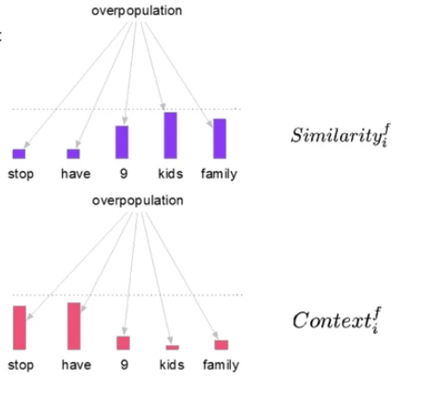
Approach

Slide 13
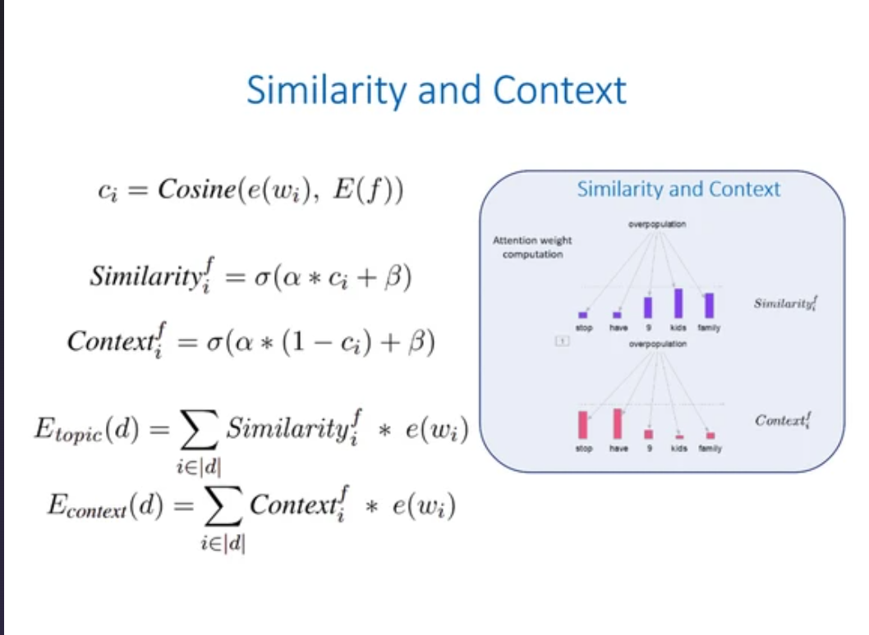
Approach

Slide 14
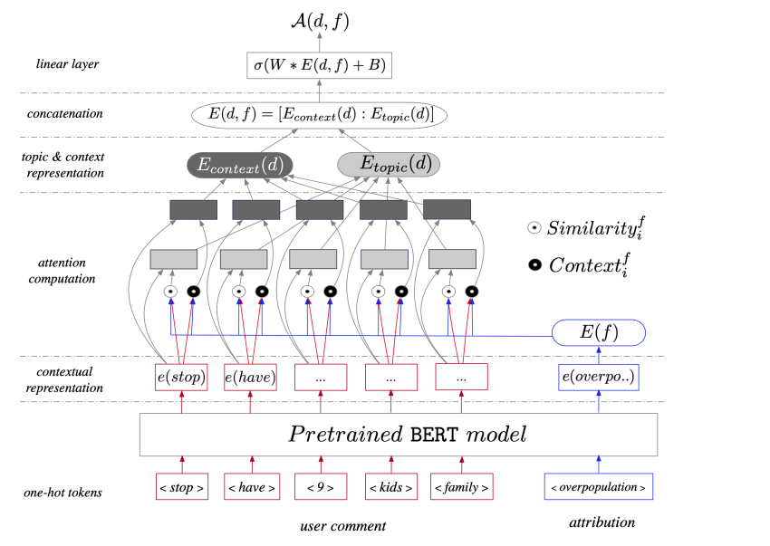
Approach

Slide 15
Performance Measures
The number of comments associated with an attribution factor was found to be extremely low in comparison to comments not associated with any attribution factors.
For this reason, the evaluation of the performance of the model is essential.
The prediction is done in two parts: attribution detection and attribution resolution.
For the detection task, we use a threshold value to determine if the sentence has any attribution.
For the resolution task we use the best attribution factor.
In presence of multiple attribution factors, we use a set membership test to assign a binary outcome.
This binary outcome is an indicator function which denotes the success or failure of the resolution task.

Slide 16
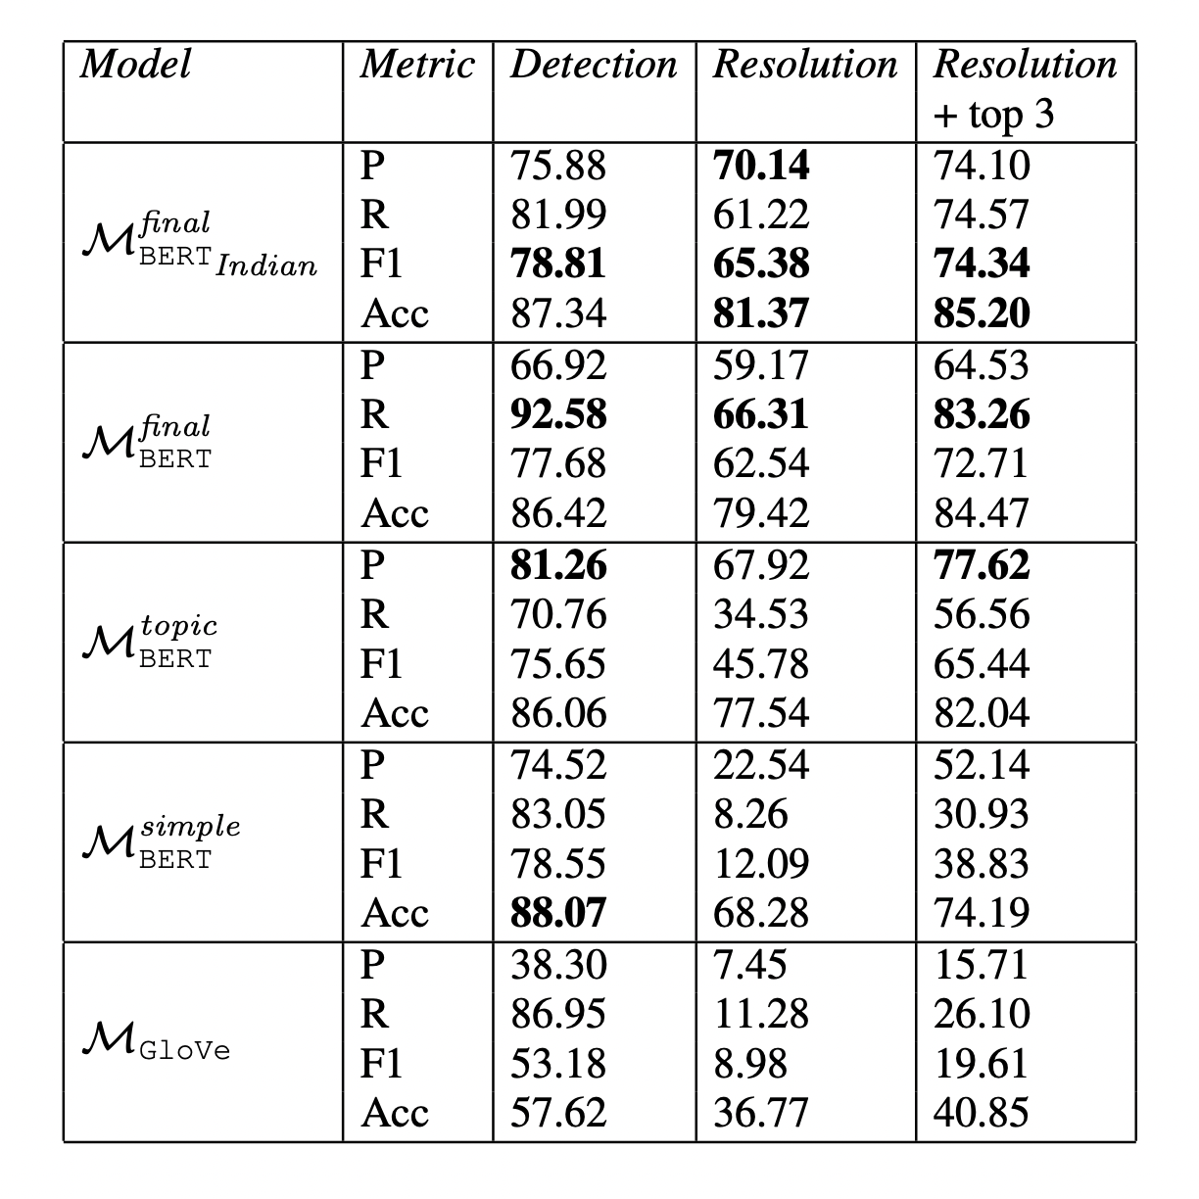
Results
The metrics used to evaluate the results are precision, recall, F1 score, and accuracy.
It is found that on the detection task, all BERT models perform similarly.
On the resolution task, the F1 score keeps improving as it gets more sophisticated.
Since most of the attribution factors are semantically close, relaxed resolution criterion is considered.
i

Slide 17
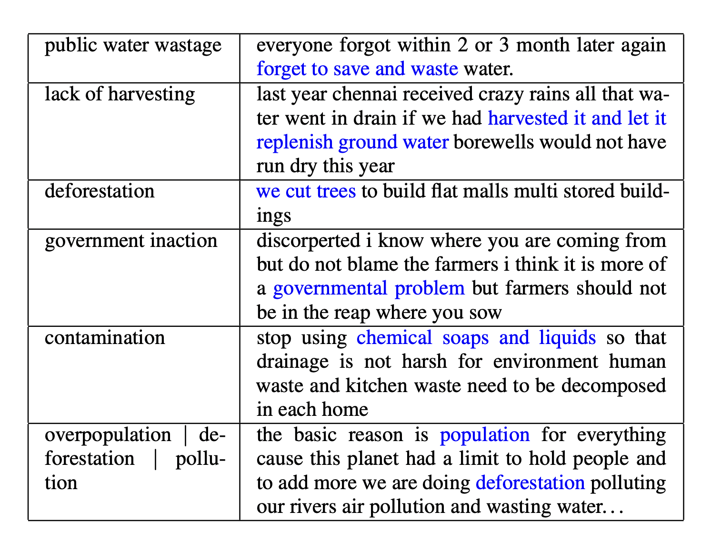
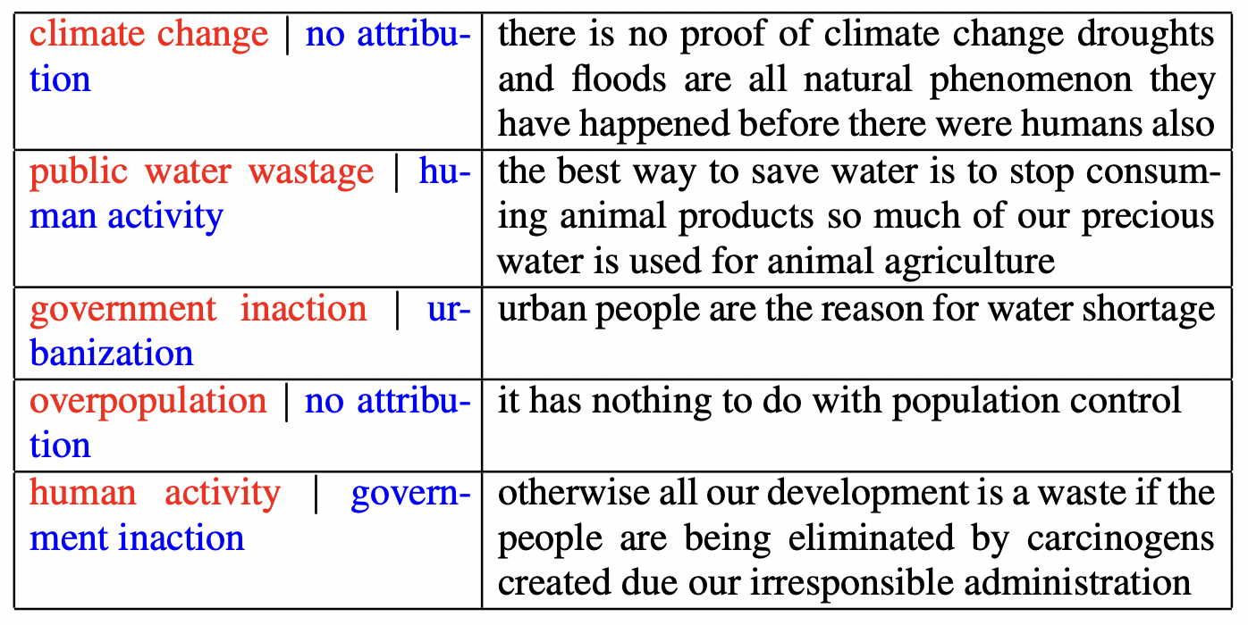
The model was able to identify the attribution factors correctly even though the comments are longer with more grammatical errors.
It could also predict multiple attribution factors with high accuracy.
There are a few failures since the model fails to understand the negation due to BERT’s inability to handle negation.

Slide 18
ANY QUESTIONS?

Slide 19
Thank you!
Rupak Sarkar, Sayantan Mahinder, Hirak Sarkar, Ashiqur R. KhudaBukhsh
Adorin Kripanand Lucas, Aishwarya Manapuram, Daksh Chaudhary
CSI5386 Seminar (Nov 28 2022)
uOttawa.ca

